Slide 1
Software Engineering Concepts (CSC205) gg
Lecture 10

Slide 2
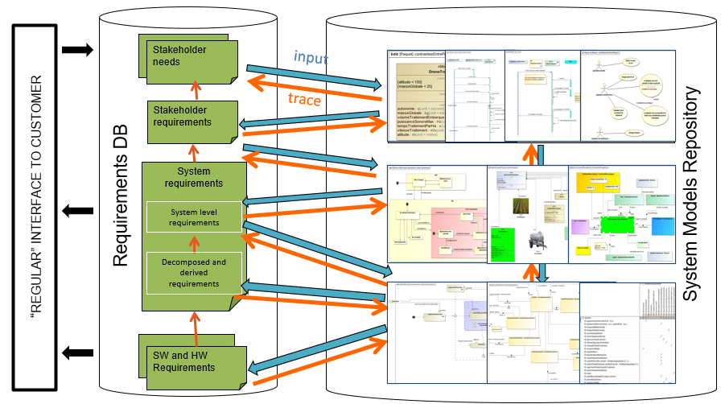
Agenda
Requirement Modelling
Scenario-Based Modelling

Slide 3
Defining the Scope
Narrow the scope by defining a more precise problem.
List all the things you might imagine the system doing.
Exclude some of these things if too broad.
Determine high-level goals if too narrow.

Slide 4
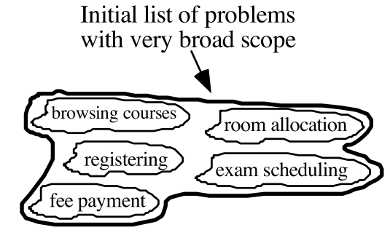
Defining the Scope: Example
A university registration system

Slide 5
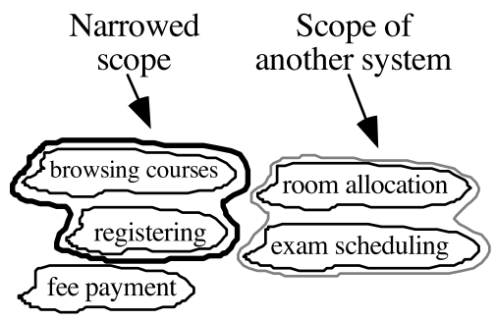
Defining the Scope: Example…
A university registration system

Slide 6
Types of Requirements
Functional requirements
Describe what the system should do
Quality requirements
Constraints on the design to meet specified levels of quality
Platform requirements
Constraints on the environment and technology of the system
Process requirements
Constraints on the project plan and development methods

Slide 7
Functional Requirements
What inputs the system should accept.
What outputs the system should produce.
What data the system should store that other systems might use.
What computations the system should perform.

Slide 8
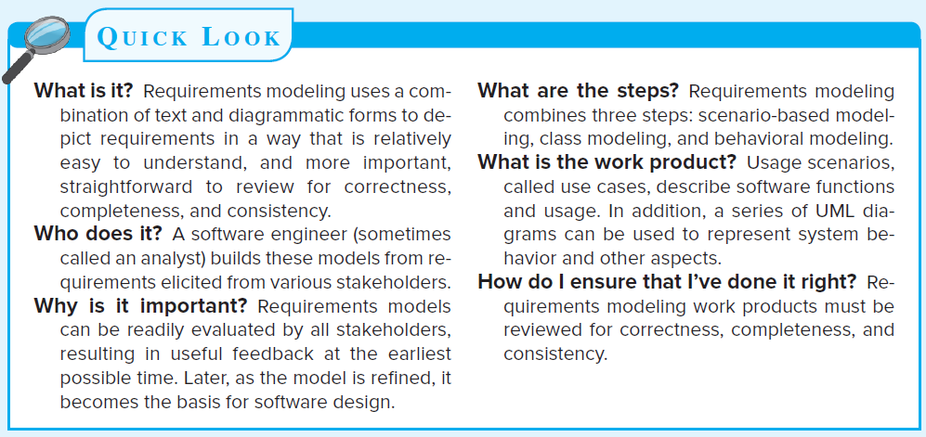

Slide 9
Modeling
“ Analysis…is concerned with devising a precise, concise, understandable, and correct model of the real world…
We create models to gain a better understanding of the actual entity to be built.
When the entity is a physical thing (e.g., a building, a plane, a machine), we can build a model that is identical in form and shape but smaller in scale.

Slide 10
System Modeling
System modeling is the process of developing abstract models of a system, with each model presenting a different view or perspective of that system.
System modeling has now come to mean representing a system using some kind of graphical notation, which is now almost always based on notations in the Unified Modeling Language (UML).
System modelling helps the analyst to understand the functionality of the system and models are used to communicate with customers.

Slide 11
Why we need Modeling?
Focus on important features, while down playing less important features.
Requirement modifications at low cost.
Verify that the systems analyst correctly understand the user requirements.

Slide 12
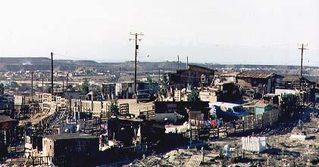
The Challenge

Slide 13
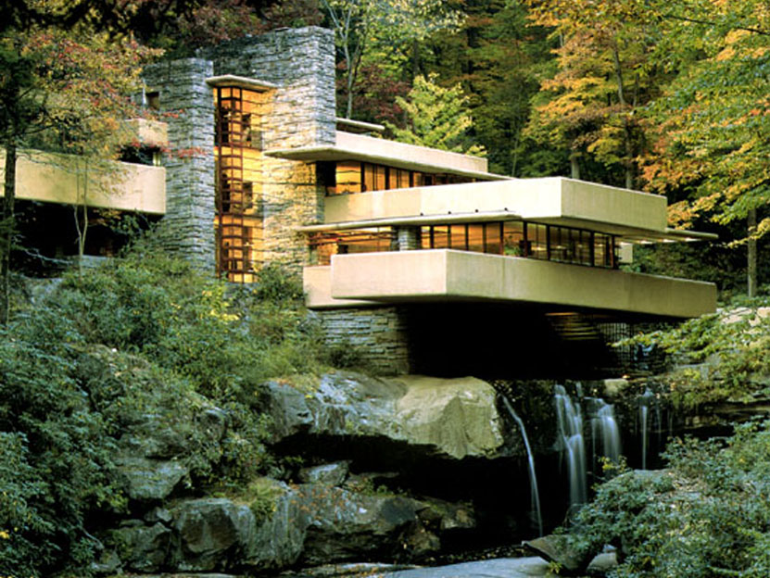
The Vision

Slide 14
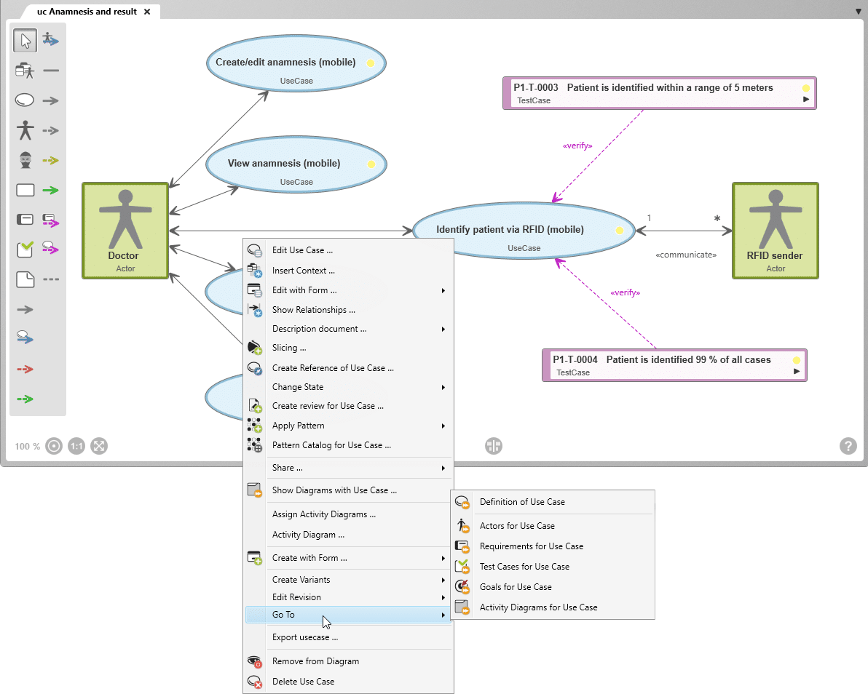
Characteristics of Good Modeling Tools
It should be graphical, with appropriate supporting textual detail.
It should allow the system to be viewed in a top down partitioned fashion.
It should have minimal redundancy.
It should help the reader to predict the system’s behavior.
It should be transparent to user.

Slide 15
Classes of Models
Analysis Models:
Represents the customer requirements by depicting the software in three domains
The information domain,
The functional domain, and
The behavioral domain
Design Model
Represents characteristics of the software that help practitioners to construct it effectively
The architecture
The user interface, and
Component level detail

Slide 16
A Bridge

Slide 17
Building the Analysis Model
Elements of the analysis model
Scenario-based elements
Functional—processing narratives for software functions
Scenario-based models of requirements from the point of view of various system “actors”
Use-case—descriptions of the interaction between an “actor” and the “system”
Class-based elements
Implied by scenarios
represent object-oriented classes (attributes and operations) and how classes collaborate to achieve system requirements.

Slide 18
Building the Analysis Model
Behavioral elements
depict how the software reacts to internal or external “events.”
State diagram
Flow-oriented elements
represent the functional elements of the system and how they transform data as they move through the system.
Data flow diagram

Slide 19
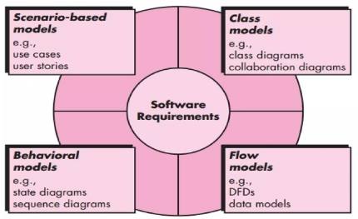

Slide 20
Scenario-Based Elements
From Req’s - an overall vision of system functions and features.
Difficult to move into more technical S/W engineering activities.
To accomplish this, developers and users can create a set of scenarios.
The scenario, often called use-cases, provide a description of how the system will be used.

Slide 21
Use Cases
“A use-case captures a contract …[that] describes the system’s behavior under various conditions as the system responds to a request from one of its stakeholders.”
In essence, a use-case tells a stylized story about how an end user interacts with the system under a specific set of circumstances.
The story can be
Narrative text,
An outline of tasks or interactions,
A template-based description, or
A diagrammatic representation.

Slide 22
Use Cases
Each scenario is described from the point-of-view of an “actor”—a person or device that interacts with the software in some way.
Each scenario answers the following questions:
Who is the primary actor, the secondary actor (s)?
What are the actor’s goals?
What preconditions should exist before the story begins?

Slide 23
Use Cases (cont..)
What variations in the actor’s interaction are possible?
What system information will the actor acquire, produce, or change?
Will the actor have to inform the system about changes in the external environment?
What information does the actor desire from the system?

Slide 24
Use Cases (cont..)
Does the actor wish to be informed about unexpected changes?
What main tasks or functions are performed by the actor?
What extensions might be considered as the story is described

Slide 26
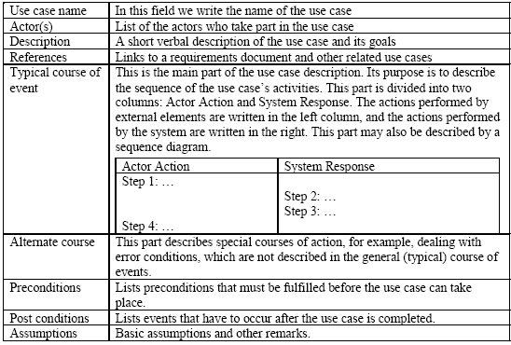
Use Case: Template

Slide 27
Use-case | InitiateMonitoring
Primary actor: | Homeowner.
Goal in context: | To set the system to monitor sensors when the homeowner leaves the house or remains inside.
Pre-conditions: | System has been programmed for a password and to recognize various sensors.
Trigger: | The homeowner decides to “set” the system, i.e., to turn on the alarm functions.
Scenario: Homeowner: observes control panel. Homeowner: enters password. Homeowner: selects “stay” or “away”. Homeowner: observed red alarm light to indicate that Safe Home has been armed.
Exceptions: Control panel is not ready: homeowner checks all sensors to determine which are open; close them. Password is incorrect (control panel beeps once): homeowner re-enters correct password. Password not recognized: monitoring and response subsystem must be contacted to reprogram password. Stay is selected: control panel beeps twice and stay light is lit; perimeter sensors are activated. Away is selected: control panel beeps three times and an away light is lit; all sensors are activated.
Priority: | Essential, must be implemented
When available: | First increment.
Frequency of use: | Many times per day.
Channel to actor: | Via control panel interface.
Secondary actors: | Support technician, sensors.

Slide 28
SRS Document Template
A "SRS template" typically refers to a Software Requirements Specification template. This is a document that outlines the detailed requirements for a software project. It includes the following outlines:
Introduction:
Purpose of the document
Scope of the software project
Definitions, acronyms, and abbreviations
Overall Description:
Product perspective
Product functions
User classes and characteristics
Operating environment
Design and implementation constraints

Slide 29
SRS Document Template (cont..)
Specific Requirements:
Functional requirements
Use cases or user stories
System behavior in response to various inputs
Non-functional requirements
Performance
Security
Usability
Reliability
Compatibility
Legal and regulatory requirement

Slide 30
SRS Document Template (cont..)
External Interface Requirements:
User interfaces
Hardware interfaces
Software interfaces
Communication interfaces
System Features:
Detailed descriptions of each feature or functionality
Dependencies between features
Data Requirements:
Data flow diagrams
Data storage requirements
Data retrieval and manipulation

Slide 31
SRS Document Template (cont..)
Quality Attributes:
Scalability
Maintainability
Testability
Portability

Slide 32
SRS Document Template (cont..)
Constraints:
Budget constraints
Time constraints
Compatibility with existing systems
Appendices:
Use case diagrams
Mockups or wireframes
Glossary

